Slide 1


Pro
Capitas

Slide 2


Today's agenda
Project recap
Problem
The Analytics team
Process
Insights
Summary

Slide 3


This project aimed to analyze customer behavior, sales performance, and retention patterns to provide actionable insights for improving business strategies.
By leveraging SQL for foundational analysis and Python for advanced computations and visualizations, we explored key metrics like retention rate, sales trends, and revenue contributions.
Project
Recap

Slide 4


Problem
Problems divided into three sections:
Basic Problems
Fundamental Insights
Intermediate Problems
Sales & Orders Trend Insights
Advanced Problems
Strategic & Customer Centric Insights

Slide 5




Kashish Agrawal
Project Coordinator
The Analytics team
Ritesh Kumar
Data Analyst

Slide 6

Process
1
Data Understanding
2
Data Cleaning
3
Data Modelling
4
Data Analysis
5
Uncover Insights

Slide 7


Insights
Health
Beauty
4119
2018
UNIQUE
CITIES
YEAR WITH
HIGHEST ORDERS
PRODUCT CATEOGORY
WITH HIGHEST SALES

Slide 8
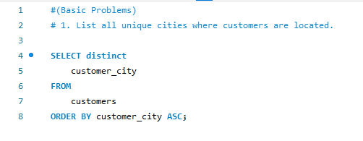
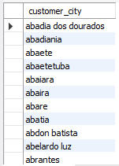
B
A
S
I
C
P
R
O
B
L
E
M
S
OUTPUT
INPUT

Slide 9
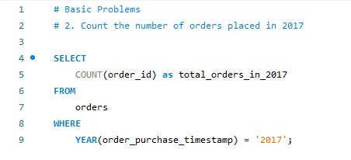
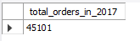
B
A
S
I
C
P
R
O
B
L
E
M
S
INPUT
OUTPUT

Slide 10
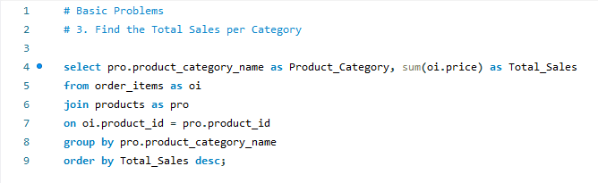
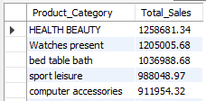
B
A
S
I
C
P
R
O
B
L
E
M
S
INPUT
OUTPUT

Slide 11
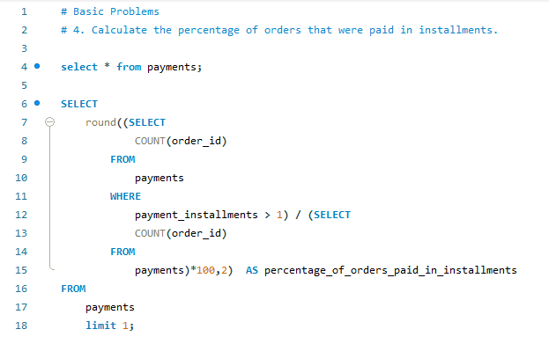
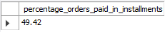
B
A
S
I
C
P
R
O
B
L
E
M
S
OUTPUT
INPUT

Slide 12
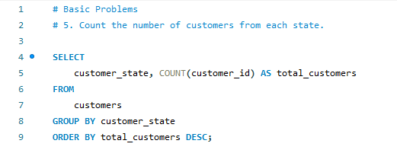
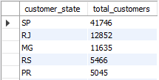
B
A
S
I
C
P
R
O
B
L
E
M
S
OUTPUT
INPUT

Slide 13
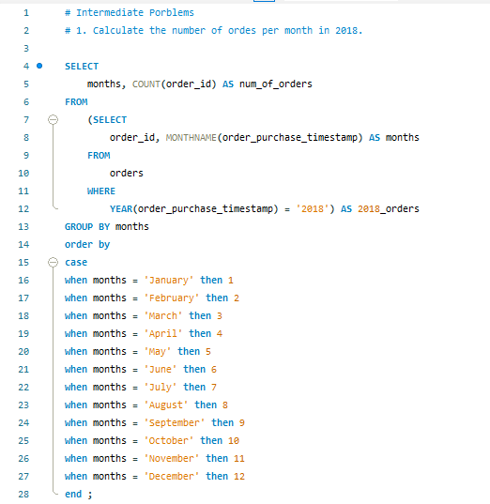
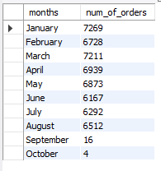
I
N
T
E
R
-
M
E
D
I
A
T
E
INPUT
P
R
O
B
L
E
M S
OUTPUT

Slide 14
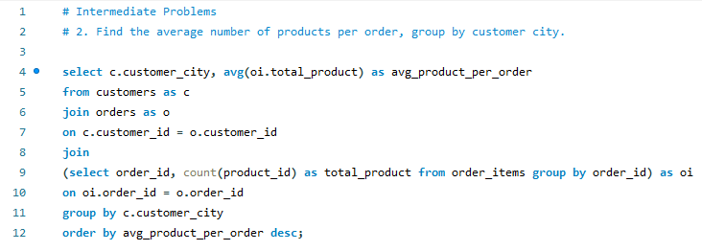
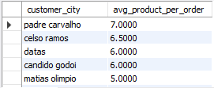
I
N
T
E
R
-
M
E
D
I
A
T
E
P
R
O
B
L
E
M S
INPUT
OUTPUT

Slide 15
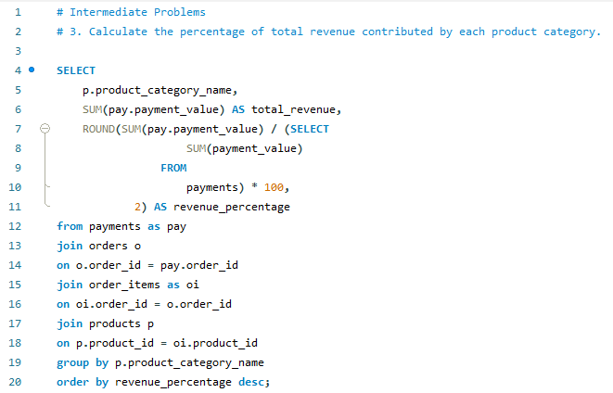
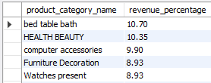
I
N
T
E
R
-
M
E
D
I
A
T
E
INPUT
P
R
O
B
L
E
M S
OUTPUT

Slide 16
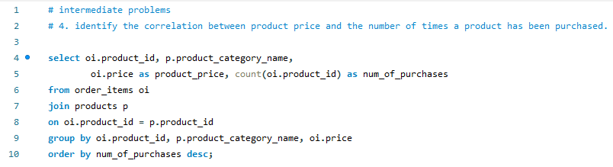
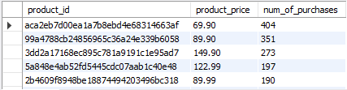
I
N
T
E
R
-
M
E
D
I
A
T
E
P
R
O
B
L
E
M S
INPUT
OUTPUT

Slide 17
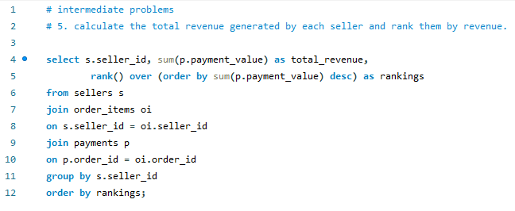
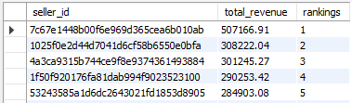
I
N
T
E
R
-
M
E
D
I
A
T
E
P
R
O
B
L
E
M S
INPUT
OUTPUT

Slide 18
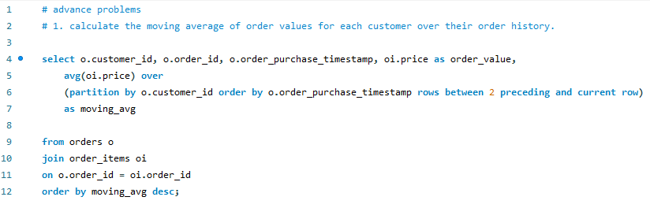
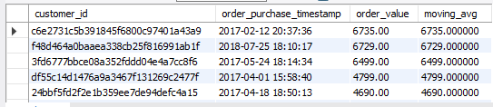
A
D
V
A
N
C
E
D
P
R
O
B
L
E
M S
INPUT
OUTPUT

Slide 19
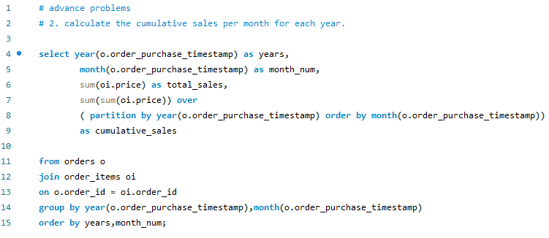
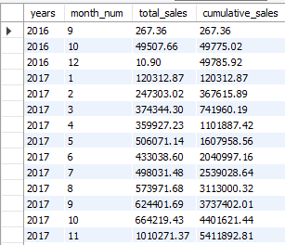
A
D
V
A
N
C
E
D
P
R
O
B
L
E
M S
OUTPUT
INPUT

Slide 20
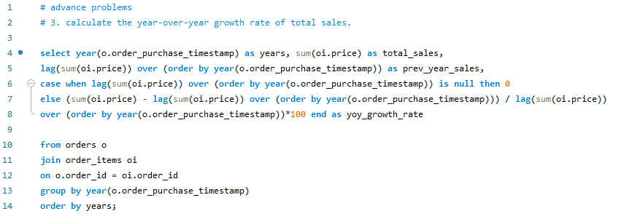
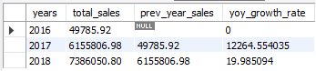
A
D
V
A
N
C
E
D
P
R
O
B
L
E
M S
INPUT
OUTPUT

Slide 21
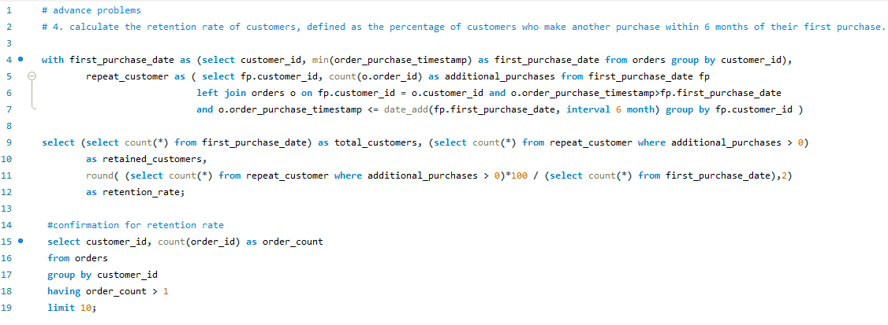
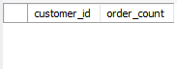
A
D
V
A
N
C
E
D
P
R
O
B
L
E
M S
INPUT
OUTPUT
No retained customer

Slide 22
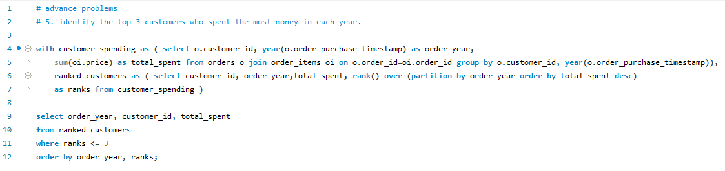
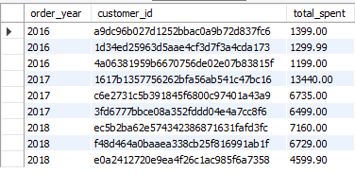
A
D
V
A
N
C
E
D
P
R
O
B
L
E
M S
INPUT
OUTPUT

Slide 23


ANALYSIS
Health Beauty & Bed Table Bath are two most popular product category purchased, showcasing that people spend on beauty and decoration the most.
Summary
&
Recommends
INSIGHTS
Correlation between product price and product purchase frequency showing that products with low price having highest order for purchase. You could use this insights to sell the product with low range price more to generate maximum revenue in best selling product categories.
NEXT STEPS
This ad-hoc analysis is insightful, but it’s time to take this analysis into large scale production for real time understanding of your business. We can show you how to do this.

Slide 24

Thank you!
ANY QUESTIONS?

